Slide 1
Run-time Systems

Slide 2
Run-time Systems
We have completed the entire front-end of a compiler:
Scanning
Parsing
Semantic analysis
These stages depend only on the properties of the source language.
They are completely independent of :
The target (machine or assembly) language
The properties of the target machine
Operating system

Slide 3
Run-time Systems
The front-end:
Enforces the language definition
Builds data structures that are needed to do code generation
If the front-end has not generated any error:
We have a valid program in the source language that we are compiling
We are ready to produce code which is a valid translation of the source code and that can executed on a given target architecture

Slide 4
Run-time Systems
The Back-end:
Optimization
Code generation
Runtime Systems:
What the target program looks like and how is it organized. Why?
We have to know what we need to generate before knowing how we generate it and how such a generation strategy makes sense.

Slide 5
Run-time Support
The target program interacts with system resources.
There is a need to manage memory when a program is running
This memory management must connect to the data objects of programs
Programs request for memory blocks and release memory blocks
Passing parameters to functions needs attention
Other resources such as printers, file systems, etc., also
need to be accessed

Slide 6
Runtime Support
Execution of a program is initially under the control of the
operating system
When a program is invoked:
The OS allocates space for the program
The code is loaded into part of the space
The OS jumps to the entry point (i.e., “main”)

Slide 7
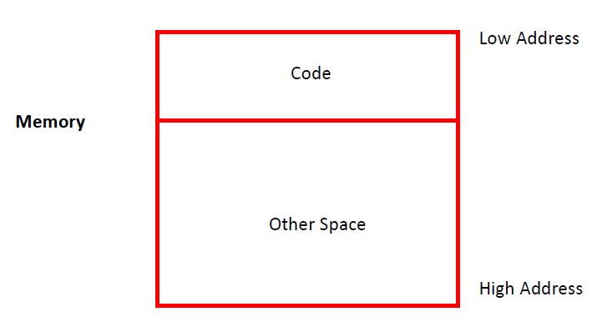
Management of Run-time Resources
The compiler is not only responsible for generating code but also handling the
associated data
Compiler needs to decide what the layout of data is going to be and then
generate code that correctly manipulates the data
References data within the code
Code and layout of data needs to be designed together
Storage Organization

Slide 8
Procedure Activations
Two goals in code generation:
Correctness
Speed
Fast as well as correct – Difficult
Two assumptions of Activation:
Execution is sequential; control moves from one point
in a program to another in a well-defined order
When a procedure is called, control always returns to
the point immediately after the call

Slide 9
Procedure Activations
An invocation of procedure P is an activation of P
The lifetime of an activation of P is
All the steps to execute P
Including all the steps in procedures P calls
The lifetime of a variable x is the portion of execution in which x is defined
Note that
Lifetime is a dynamic (run-time) concept
Scope is a static concept

Slide 10
Procedure Activations
Observation
When P calls Q, then Q returns before P returns
Lifetimes of procedure activations are properly nested
Activation lifetimes can be depicted as a tree
int main {
int g() { return 1; };
int f() { return g(); };
int main() {{ g(); f(); }};
}
main
g()
f()
g()

Slide 11
Procedure Activations
class main {
int g() : { return1; };
int f(int x) { if (x == 0) then return g(); else
return 1+ f(x - 1); };
int main ( ) { f(3); };
}
The activation tree may be different for every program input
Since activations are properly nested, a stack can track currently
active procedures
Nesting of activations

Slide 12
Activation Records
Information needed to manage one procedure activation
is called an activation record (AR) or frame
If procedure F calls G, then G’s activation record
contains a mix of info about F and G.
F is “suspended” until G completes, at which point F
resumes
G’s AR contains information needed to
Complete execution of G
Resume execution of F

Slide 13
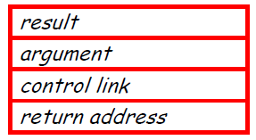
Activation Records
Space for G’s return value
Actual parameters
Pointer to the previous activation record
The control link; points to AR of caller of G
Machine status prior to calling G
Contents of registers & program counter
Local variables
Other temporary values
AR

Slide 14
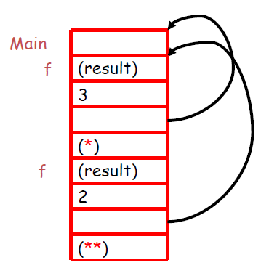
Activation Records
class main {
int g() : { return1; };
int f(int x) { if (x == 0) then return g();
else return 1+ f(x - 1);(**) };
int main() {f(3); (*)};
}
AR:
main() has no argument or local variables and its result is never used; its AR is
uninteresting
(*) and (**) are return addresses of the invocations of f

Slide 15
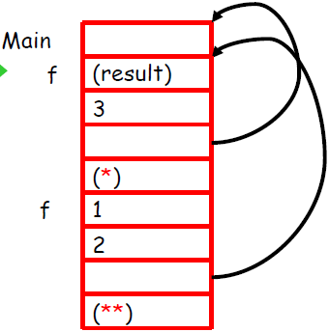
Activation Records
The advantage of placing the return value 1st in a frame is that the
caller can find it at a fixed offset from its own frame
Stack state after the call to the 2nd invocation of f returns

Slide 16
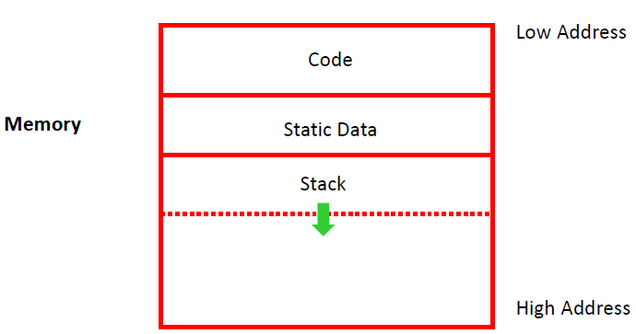
Global Data
All references to a global variable point to the same object
Can’t store a global in an activation record
Globals are assigned a fixed address statically

Slide 17
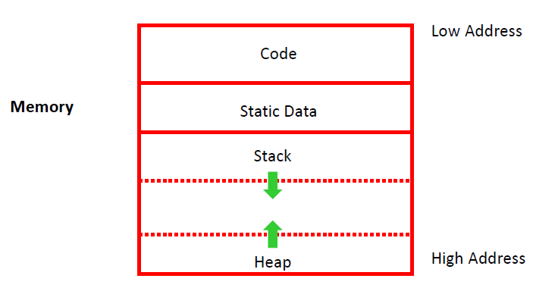
Heap
A value that outlives the procedure that creates it cannot be kept in AR
method foo() { new Bar }
The Bar value must survive deallocation of foo’s AR
A heap is generally used to store dynamically allocated data

Slide 18
Alignment
Most modern machines are 32 or 64 bit
Machines are either byte or word addressable
Data is word aligned if it begins at a word boundary
Machines generally have alignment restrictions
Accessing mis-aligned data incurs significant overhead
– say 5x slower
Padding is used to word align next data object in memory
Most frequently used with strings
Say we have the string “Hello” – requires 2 “padding” characters

Slide 19
Code Generation

Slide 20
Stack Machines
Only storage is a stack
An instruction r = F(a₁,…a_{n}):
Pops n operands from the stack
Computes the operation F using the operands
Pushes the result r on the stack
Consider two instructions:
push i - push integer i on the stack
add - add two integers

Slide 21
Stack Machines
A program:
push 7
push 5
Add
Stack machines provide a simple machine model
Simple compiler
Inefficient
Location of the operands/result is not explicitly stated
Always the top of the stack

Slide 22
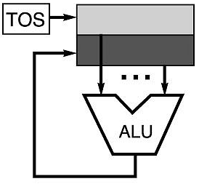
Stack Architectures
Instruction set:
add, sub, mult, div, . . .
push A, pop A
Example: A*B - (A+C*B)
push A
push B
mul
push A
push C
push B
mul
add
sub
A
B
A*B
A
C
B
B*C
A+B*C
result
A
A*B
A
C
A
A*B
A*B
A
A*B
A*B

Slide 23
Stack Machines
Stack machine Vs. register machine
add instead of add r₁, r₂, r₃
More compact programs
There is an intermediate point between a pure stack machine and a
pure register machine
An n-register stack machine
Conceptually, keep the top n locations of the pure stack
machine’s stack in registers
1-register stack machine
The register is called the accumulator

Slide 24
Stack Machines
In a pure stack machine
An add does 3 memory operations: Two reads and one write
In a 1-register stack machine the add does
acc ← acc + top_of_stack
In general, for an operation op(e₁,…,e_{n})
e₁,…,e_{n} are subexpressions
For each e_{i} (0 < i < n)
Compute e_{i}
Push result on the stack
Pop n-1 values from the stack, compute op
Store result in the accumulator

Slide 25
Stack Machines
Operations for the stack machine with accumulator: 3 + (7 + 5)
Code | Accumulator | Stack
acc ← 3 | 3 | <init>
push acc | 3 | 3, <init>
acc ← 7 | 7 | 3, <init>
push acc | 7 | 7, 3, <init>
acc ← 5 | 5 | 7, 3, <init>
acc ← acc + top_of_stack | 12 | 7, 3, <init>
pop | 12 | 3, <init>
acc ← acc + top_of_stack | 15 | 3, <init>
pop | 15 | <init>

Slide 26
Stacks: Pros and Cons
Pros
Good code density (implicit top of stack)
Low hardware requirements
Easy to write a simpler compiler for stack architectures
Cons
Stack becomes the bottleneck
Little ability for parallelism or pipelining
Data is not always at the top of stack when need, so additional instructions like TOP and SWAP are needed
Difficult to write an optimizing compiler for stack architectures

Slide 27
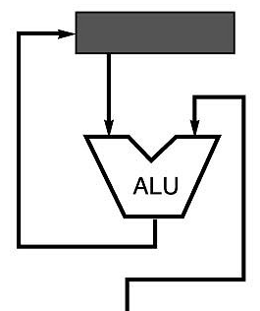
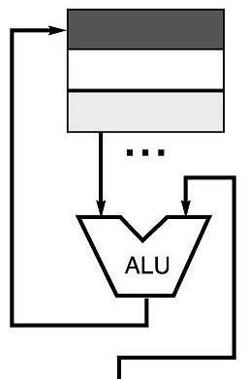
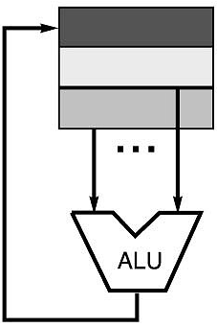
Code Sequence C = A + B for Four Instruction Sets
Stack | Accumulator (Stack with 1 reg.) | Register (register-memory) | Register (load-store)
Push A Push B Add Pop (to) C | PUSH A Add B Pop (to) C | Load R1, A Add R1, B Store C, R1 | Load R1,A Load R2, B Add R3, R1, R2 Store C, R3
memory
memory
acc = acc + mem[C]
R1 = R1 + mem[C]
R3 = R1 + R2

Slide 28
Code Generation
… to continue

Slide 29
Code Generation
MIPS (originally an acronym for Microprocessor without Interlocked Pipeline Stages) is a reduced instruction set computer (RISC) instruction set architecture (ISA) developed by MIPS Technologies
Code that can be executed on a real machine
The MIPS processor
We will simulate a stack machine model using MIPS
instructions and registers
The accumulator is kept in MIPS register $a0
The stack is kept in memory
The stack grows towards lower addresses in MIPS
Address of the next location on stack is kept in register $sp
Top of the stack is at address $sp + 4
MIPS uses RISC processor model
32 general purpose registers (32 bits each)
We use $sp (stack pointer), $a0 (accumulator) and $t1 (a temporary register)

Slide 30
MIPS Instructions
lw reg1 offset(reg2) /*load word*/
Load 32-bit word from address reg₂ + offset into reg₁
add reg₁ reg₂ reg₃
reg₁ ← reg₂ + reg₃
sw reg1 offset(reg₂) /*store word*/
Store 32-bit word in reg₁ at address reg₂ + offset
addiu reg₁ reg₂ imm (#) /*add immediate unsigned*/
reg₁ ← reg₂ + imm where # → a number
“u” means overflow is not checked
li reg imm (#) /*load immediate*/
reg ← imm

Slide 31
Example
Stack-machine code for 7 + 5 in MIPS
acc ← 7
push acc
acc ← 5
acc ← acc + top_of_stack
pop
li $a0 7
sw $a0 0($sp)
addiu $sp $sp -4
li $a0 5
lw $t1 4($sp)
add $a0 $a0 $t1
addiu $sp $sp 4

Slide 32
Code Generation
A language with integers and integer operations
P → D; P | D
D → def id(ARGS) = E;
ARGS → id, ARGS | id
E → int | id | if E₁ = E₂ then E₃ else E₄
| E₁ + E₂ | E₁ – E₂ | id(E₁, …, E_{n})
A program consists of a list of declarations
A declaration is a function definition.
The function takes a list of identifiers as arguments.
The function body is an expression.
Expressions are integers, identifiers, if-then-else with a predicate which allows the equality test, sums and differences of expressions and function calls.
The first function definition in the list is the entry point, that is the main routine.

Slide 33
Code Generation
This language may be used to define the fibonacci function:
def fib(x) = if x = 1 then 0 else
if x = 2 then 1 else
fib(x - 1) + fib(x – 2)
To generate code for this language, we generate MIPS code for each expression e that:
Computes the value of e in $a0
Preserves $sp and the contents of the stack
We define a code generation function cgen(e) whose result is the code generated for e

Slide 34
Code Generation
cgen(e) is going to work by cases.
The code to evaluate a constant simply copies it into the accumulator:
cgen(i) = li $a0 i
cgen(e₁ + e₂) =
cgen(e₁)
sw $a0 0($sp)
addiu $sp $sp - 4
cgen(e₂)
lw $t1 4($sp)
add $a0 $t1 $a0
addiu $sp $sp 4
This preserves the stack, as required
The code for + is a template with “holes” for code for evaluating e₁ and e₂
Stack machine code generation is recursive
Code generation for expressions can be done as a recursive-descent of the AST

Slide 35
Code Generation
MIPS instruction: sub reg₁ reg₂ reg₃
Implements reg₁ ← reg₂ - reg₃
cgen(e₁ - e₂) =
cgen(e₁)
sw $a0 0($sp)
addiu $sp $sp - 4
cgen(e₂)
lw $t1 4($sp)
sub $a0 $t1 $a0
addiu $sp $sp 4

Slide 36
Code Generation
Write MIPS assembly code for the given expressions following the 1-register stack machine model:
1 + ( 2 - 3)
(5 - 4) + 3

Slide 37
Code Generation
… to continue

Slide 38
Condition Checking
MIPS instruction: beq reg₁ reg₂ label
Branch to label if reg₁ = reg₂
MIPS instruction: b label
Unconditional branch to label
cgen(if e₁ = e₂ then e₃ else e₄) =
cgen(e₁)
sw $a0 0($sp)
addiu $sp $sp - 4
cgen(e₂)
lw $t1 4($sp)
addiu $sp $sp 4
beq $a0 $t1 True_branch
False_branch:
cgen(e₄)
b end_if
True_branch:
cgen(e₃)
End_if:

Slide 39
Code Generation
A language with integers and integer operations
P → D; P | D
D → def id(ARGS) = E;
ARGS → id, ARGS | id
E → int | id | if E₁ = E₂ then E₃ else E₄
| E₁ + E₂ | E₁ – E₂ | id(E₁, …, E_{n})

Slide 40
Function Calls
Code for function calls and function definitions depends on the layout of the AR
A very simple AR suffices for this language:
The result is always in the accumulator
No need to store the result in the AR
The activation record holds actual parameters
For f(x₁,…,x_{n}) push x_{n},…,x₁ on the stack
These are the only variables (no other local or global variables) in this language (constraint)
The stack discipline guarantees that on function exit $sp is the same as it was on function entry (preservation of the SP)
No need for a control link

Slide 41
Function Calls
A pointer to the current activation is useful
This pointer lives in register $fp (frame pointer)
So, for this language, an AR with the caller’s frame pointer, the actual parameters, and the return address suffices
Consider a call to f(x,y), the AR is:
fp
Old_fp
y
AR of f
x
sp

Slide 42
Function Calls
The calling sequence is the instructions (of both caller and callee) to set up a function invocation
New MIPS instruction: jal label /*jump and link*/
Jump to label, save address of next instruction in $ra
To be used in Caller
New MIPS instruction: jr reg
Jump to address in register reg
To be used in Callee

Slide 43
Function Calls
Code in Caller
cgen(f(e₁,…,e_{n})) =
sw $fp 0($sp)
addiu $sp $sp - 4
cgen(e_{n})
sw $a0 0($sp)
addiu $sp $sp - 4
…
cgen(e₁)
sw $a0 0($sp)
addiu $sp $sp - 4
jal f_entry
The caller saves its fp to stack
Then it saves the actual parameters in reverse order
Execute jump and link to call
Finally the caller saves the return address in register $ra
The AR so far is 4*n+4 bytes long
Code in the caller side

Slide 44
Code Generation – Function Calls
Code in Callee
cgen(def f(x₁,…,x_{n})= e) =
F_entry: move $fp $sp
sw $ra 0($sp)
addiu $sp $sp - 4
cgen(e)
lw $ra 4($sp)
addiu $sp $sp z
lw $fp 0($sp)
jr $ra
Store the $sp as the $fp of the current function.
Store the return address ($ra) to stack
Execute expression e
Pop return address
Store the current fp to $fp
Jump to $ra to return calling function
The frame pointer points to the top, not the bottom
The callee pops the return address, the actual arguments and the saved value of the frame pointer
z = 4*n + 8

Slide 45
Function Calls
The “variables” of a function are just its parameters
They are all in the AR
Pushed by the caller
Problem: Because the stack grows when intermediate results are saved, the variables are not at a fixed offset from $sp
Solution: use a frame pointer
Always points to the return address on the stack
Let x_{i} be the i^{th} (i = 1,…,n) formal parameter of the function for which code is being generated
cgen(x_{i}) = lw $a0 z($fp) ( z = 4*i )

Slide 46
Handling Temporaries

Slide 47
Code Generation
In production compilers:
Emphasis is on keeping values in registers
Especially the current stack frame
Intermediate results are laid out in the AR, not pushed and popped from the stack

Slide 48
Code Generation – Handling Temporaries
Let NT(e) = Number of temporaries needed to evaluate e
NT(e₁ + e₂)
Needs at least as many temporaries as NT(e₁)
Needs at least as many temporaries as NT(e₂) + 1
Space used for temporaries in e₁ can be reused for temporaries in e₂
NT(e₁ + e₂) = max(NT(e₁), 1 + NT(e₂))
NT(if e₁ = e₂ then e₃ else e₄) = max(NT(e₁),1 + NT(e₂), NT(e₃), NT(e₄))
NT(id(e₁,…,e_{n}) = max(NT(e₁),…,NT(e_{n}))
NT(int / id) = 0

Slide 49
Code Generation
def fib(x) = if x = 1 then 0 else
if x = 2 then 1 else
fib(x - 1) + fib(x – 2)
For a function definition f(x₁,…, x_{n}) = e the AR has
2 + n + NT(e) elements
Return address (1)
Frame pointer (1)
n arguments (n)
NT(e) locations for intermediate
results (NT(e))
2 Temporary
variables required
Old_fp
X_{n}
…
X₁
Return Address
Temp NT(e)
…
Temp 1

Slide 50
Code Generation
Code generation must know how many temporaries are in use at each point
Add a new argument to code generation
The position of the next available temporary
The temporary area is used like a small, fixed-size stack
cgen(e₁ + e₂) =
cgen(e₁)
sw $a0 0($sp)
addiu $sp $sp - 4
cgen(e₂)
lw $t1 4($sp)
add $a0 $t1 $a0
addiu $sp $sp 4
cgen(e₁ + e₂, nt) =
cgen(e₁, nt)
sw $a0 nt($fp)
cgen(e₂, nt + 4)
lw $t1 nt($fp)
add $a0 $t1 $a0

Slide 51
Code Generation Example
def sumto(x) = if x = 0
then 0
else
x + sumto(x – 1)

Slide 52
Code Optimization

Slide 53
Code Optimization
Most complexity in modern compilers is in the optimizer
Also by far the largest phase
Optimizations can be performed on
AST / DAG
Machine independent optimization but too high level
Assembly code
Target (machine) dependent optimization
On an intermediate language

Slide 54
Basic Blocks
A basic block is a maximal sequence of instructions with:
no labels (except at the first instruction), and
no jumps (except in the last instruction)
Idea:
Cannot jump into a basic block (except at beginning)
Cannot jump out of a basic block (except at end)
A basic block is a single-entry, single-exit, straight-line code segment
The property of sequential control flow can be useful for many optimizations.

Slide 55
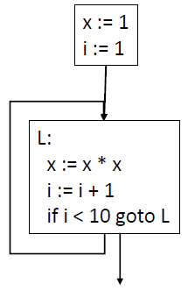
Control Flow Graphs
Control-Flow Graph (CFG)
Models the way that the code transfers control between blocks in the procedure.
Node: a single basic block
Edge: transfer of control between basic blocks.
All return nodes are terminal

Slide 56
Code Optimization
Optimization seeks to improve a program’s resource utilization
Execution time (most often)
Code size
Network messages sent
Memory Usages
Disk Accesses
Power
Optimization should not alter what the program computes
The answer before and after optimization must remain same

Slide 57
Code Optimization
There are three granularities of optimizations
Local optimizations
Apply to a basic block in isolation
Global optimizations
Apply to a control-flow graph (method body) in isolation
Inter-procedural optimizations
Apply across method boundaries
Most compilers do local and global optimizations but not the third
Often a conscious decision is made not to implement the fanciest optimization known
Goal: Maximum benefit for minimum cost

Slide 58
Local Optimization
Algebraic simplification and Reassociation
Simplifications use algebraic properties or particular operator-operand combinations to simplify expressions.
Reassociation refers to using properties such as associativity, commutativity and distributivity to rearrange an expression to enable other optimizations

Slide 59
Local Optimization
Algebraic simplification and Reassociation
Simplification Examples:
Example: Re-arrangement + constant folding
x+0 = x 0+x = x x*1 = x 1*x = x 0/x = 0 x-0 = x
b && true = b b && false = false
b || true = true b || false = b
b = 5 + a + 10 ;
t0 = 5 ;
t1 = t0 + a ;
t2 = t1 + 10 ;
b = t2 ;
t0 = 15 ;
t1 = a + t0 ;
b = t1 ;

Slide 60
Local Optimization
Constant Folding
Evaluation at compile-time of expressions whose operands are known to be constant
Example
t0 = 10 ;
t1 = 5 ;
t2 = t0 * t1 ;
t3 = 6 ;
t4 = t2 + t3 ;
t5 = t4 – b;
a = t5 ;
t0 = 56 ;
t1 = t0 – b ;
a = t1 ;
a = 10 * 5 + 6 - b;

Slide 61
Code Optimization
…. to continue

Slide 62
Local Optimization
Constant Propagation
If a variable is assigned a constant value, then subsequent uses of that variable can be replaced by the constant as long as no intervening assignment has changed the value of the variable.
Example:
t0 = 12 ;
t1 = arr + t0 ;
t2 = *(t1) ;
t0 = *(arr + 12) ;
Constant propagation + rearrangement cuts no. of regs. and insns. from 4 to 2
lw $t0, -8($fp)
lw $t1, 12($t0)
li $t0, 12
lw $t1, 8($fp)
add $t2, $t1, $t0
lw $t3, 0($t2)

Slide 63
Local Optimization
Operator Strength Reduction
Replaces an operator by a "less expensive" one
Often performed as part of loop-induction variable elimination
Example:
t1 = i;
L0:
If t1>100 Goto L1 ;
t2 = 4 * t1 ;
t3 = arr + t2 ;
*(t3) = 0 ;
t1 = t1 + 1 ;
Jump L0
L1:
t1 = arr ;
L0: If i > 100 Goto L1 ;
* t1 = 0;
t1 = t1 + 4;
i = i + 1 ;
L1:
while (i < 100) {
arr[i] = 0;
i = i + 1;
}

Slide 64
Local Optimization
Copy Propagation
Similar to constant propagation, but generalized to non-constant values
For a = b, we can replace later occurrences of a with b (assuming there are no changes to either variable in-between)
Example
t2 = t1 ;
t3 = t2 * t1;
t4 = t3 ;
t5 = t3 * t2 ;
c = t5 + t4 ;
t3 = t1 * t1 ;
t5 = t3 * t1 ;
c = t5 + t3 ;

